Slide 1


Game Theoretic Allocation of Surveillance Robots in Adversarial Environments
Sailik Sengupta
Aditya P. Mishra

Slide 2



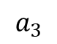
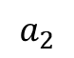
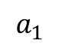
Allocating robots to monitor multiple factories
$$a_{2}$$
$$a_{3}$$
$$a_{1}$$

Slide 3
Allocating robots to monitor multiple factories
?
?
?
$$a_{2}$$
$$a_{3}$$
$$a_{1}$$

Slide 4
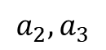
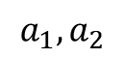
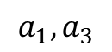
Game-Theoretic modelling
Defender plays first!
$$a_{1},a_{2}$$
$$a_{2},a_{3}$$
$$a_{1},a_{3}$$

Slide 5
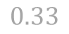
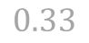
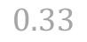
Game-Theoretic modelling
Defender plays first!
Attacker knows defender’s strategy but not necessarily what was played!
$$0.33$$
$$a_{1},a_{2}$$
$$a_{2},a_{3}$$
$$0.33$$
$$a_{1},a_{3}$$
$$0.33$$

Slide 6
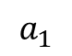
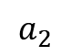
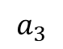
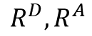
Game-Theoretic modelling
Defender plays first!
Attacker knows defender’s strategy but not necessarily what was played. Thus, needs to find the Stackelberg Equilibrium.
$$a_{1}$$
$$a_{2}$$
$$a_{3}$$
$$a_{1},a_{2}$$
$$R^{D},R^{A}$$
$$a_{2},a_{3}$$
$$a_{1},a_{3}$$

Slide 7
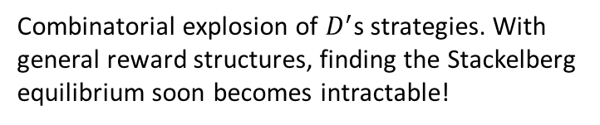
Game-Theoretic modelling
$$a_{1}$$
$$a_{2}$$
$$a_{3}$$
$$a_{1},a_{2}$$
Combinatorial explosion of $D^{′}$s strategies. With general reward structures, finding the Stackelberg equilibrium soon becomes intractable!
$$a_{2},a_{3}$$
$$a_{1},a_{3}$$

Slide 8
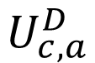
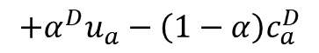
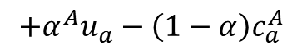
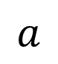
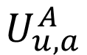
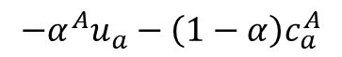
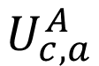
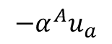
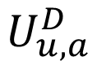
Reward design
$$a$$
Covered
Not covered
Covered
Not covered
$$U_{c,a}^{D}$$
$$U_{u,a}^{D}$$
$$U_{c,a}^{A}$$
$$U_{u,a}^{A}$$
$$+α^{D}u_{a}−\left(1−α\right)c_{a}^{D}$$
$$−α^{A}u_{a}$$
$$−α^{A}u_{a}−\left(1−α\right)c_{a}^{A}$$
$$+α^{A}u_{a}−\left(1−α\right)c_{a}^{A}$$

Slide 9

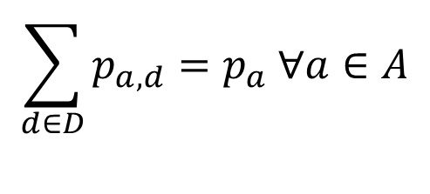
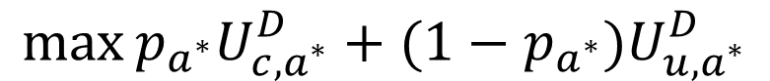
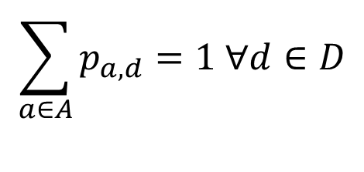
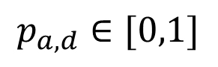
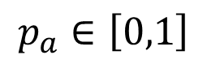
Optimization problem to obtain strategy
For that attacker choosing to attack $a^{∗},$ we solve
$$\max{{p_{a^{∗}}U}_{c,a^{∗}}^{D}+(1−p_{a^{∗}})U_{u,a^{∗}}^{D}}$$
$$p_{a}∈\left[0,1\right]$$
$$p_{a,d}∈[0,1]$$
$$\sum_{a∈A}{p_{a,d}}=1 ∀d∈D$$
$$\sum_{d∈D}{p_{a,d}}=p_{a} ∀a∈A$$
$${p_{a^{∗}}U}_{c,a^{∗}}^{A}+\left(1−p_{a^{∗}}\right)U_{u,a^{∗}}^{A}≥{p_{a}U}_{c,a}^{A}+(1−p_{a})U_{u,a}^{A}$$
Kiekintveld, Christopher, et al. "Computing optimal randomized resource allocations for massive security games." Proceedings of The 8th International Conference on Autonomous Agents and Multiagent Systems-Volume 1. International Foundation for Autonomous Agents and Multiagent Systems, 2009

Slide 10
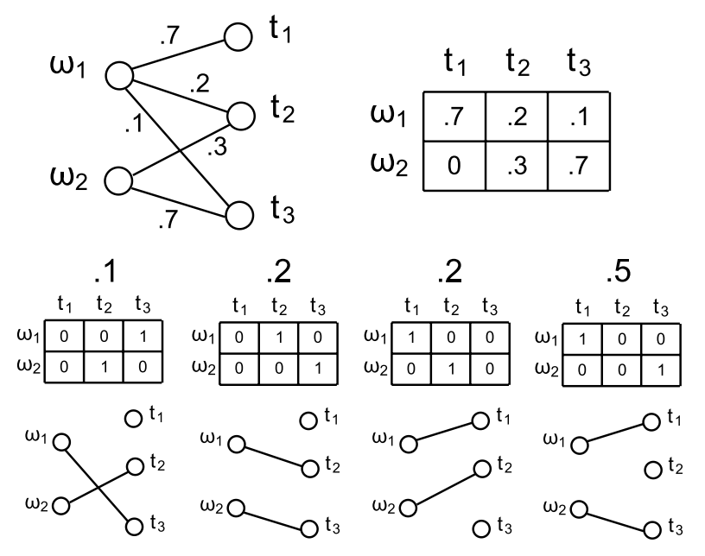
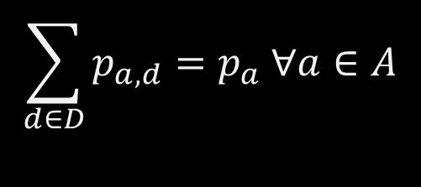

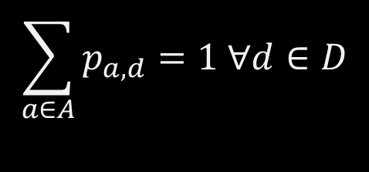
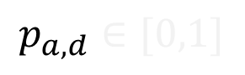

Finding implementable strategies
$$\max{{p_{a^{∗}}U}_{c,a^{∗}}^{D}+(1−p_{a^{∗}})U_{u,a^{∗}}^{D}}$$
$$p_{a}∈\left[0,1\right]$$
$$p_{a,d}∈[0,1]$$
$$\sum_{a∈A}{p_{a,d}}=1 ∀d∈D$$
$$\sum_{d∈D}{p_{a,d}}=p_{a} ∀a∈A$$
$${p_{a^{∗}}U}_{c,a^{∗}}^{A}+\left(1−p_{a^{∗}}\right)U_{u,a^{∗}}^{A}≥{p_{a}U}_{c,a}^{A}+(1−p_{a})U_{u,a}^{A}$$

Slide 11
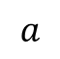
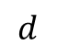
Finding implementable strategies
$$d$$
$$a$$
$$\max{{p_{a^{∗}}U}_{c,a^{∗}}^{D}+(1−p_{a^{∗}})U_{u,a^{∗}}^{D}}$$
$$p_{a}∈\left[0,1\right]$$
$$p_{a,d}∈[0,1]$$
$$\sum_{a∈A}{p_{a,d}}=1 ∀d∈D$$
$$\sum_{d∈D}{p_{a,d}}=p_{a} ∀a∈A$$
$${p_{a^{∗}}U}_{c,a^{∗}}^{A}+\left(1−p_{a^{∗}}\right)U_{u,a^{∗}}^{A}≥{p_{a}U}_{c,a}^{A}+(1−p_{a})U_{u,a}^{A}$$
Budish, Eric, et al. "Designing random allocation mechanisms: Theory and applications." American Economic Review 103.2 (2013): 585-623.

Slide 12
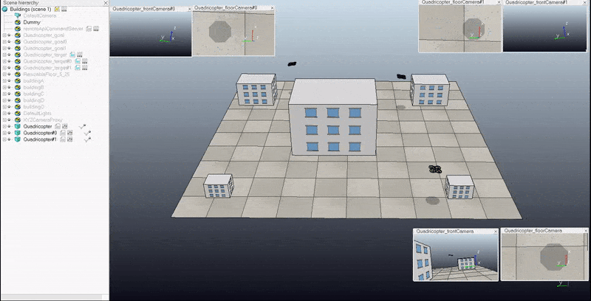
Experimental Setup
Scenario Description in V-REP
3 Quadcopters
5 Buildings
Algorithms we leverage
Physics Simulator
Path Planning using OMPL (RRTConnect)
Static object collision avoidance
Client-Server Architecture

Slide 13
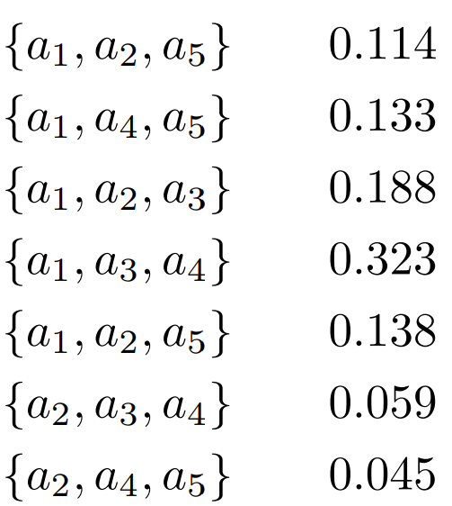
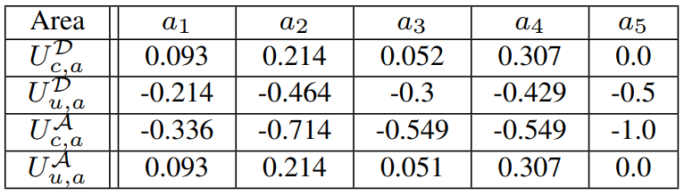
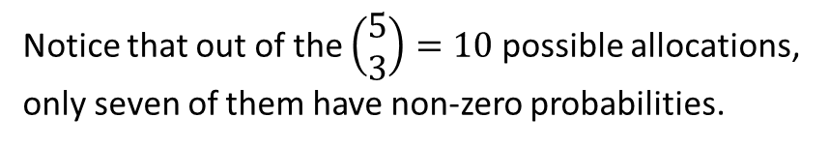
Experimental Scenario
Allocation of drones to areas
Perimeter and Rewards associated with an area have been normalized for obtaining the utility values of the game.
Notice that out of the $\left(\begin{matrix}5 \\ 3\end{matrix}\right)=10$ possible allocations, only seven of them have non-zero probabilities.

Slide 14
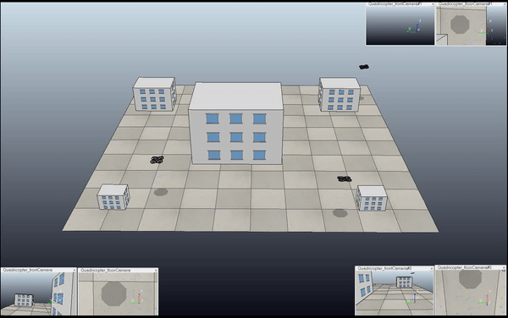

Slide 15
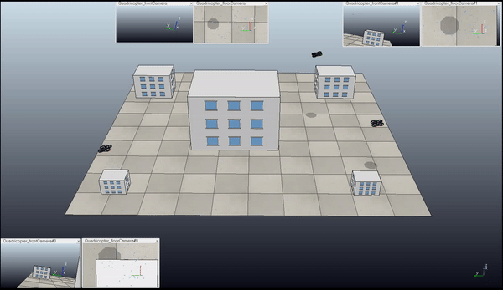

Slide 16
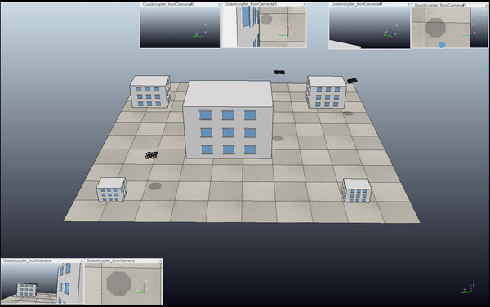

Slide 17
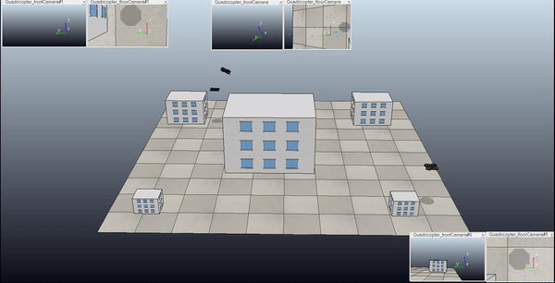

Slide 18
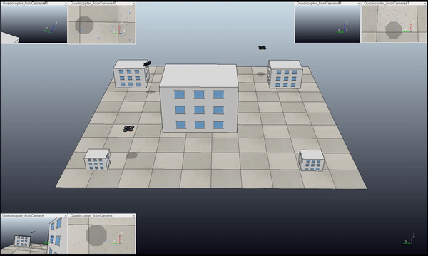

Slide 19
Conclusions
Formulated the problem of multi-robot allocation for surveillance in adversarial environments as a Stackelberg game.
Solved the equilibrium of this game in polynomial time by designing a specific reward structure.
Demonstrated using a scenario where the defender has 3 robots and wants to monitor 5 locations with different utilities.

Slide 20

Conclusions
THANK YOU!
Formulated the problem of multi-robot allocation for surveillance in adversarial environments as a Stackelberg game.
Solved the equilibrium of this game in polynomial time by designing a specific reward structure.
Demonstrated using a scenario where the defender has 3 robots and wants to monitor 5 locations with different utilities.

